Slide 1

KS3 Mathematics
D3 Scatter Graphs
Notes:
The aim of this unit is to teach pupils to:
Construct graphs and diagrams to represent data, on paper and using ICT.
Interpret diagrams and graphs, and draw inferences.
Compare two simple distributions using the range, mode, mean or median.
Material in this unit is linked the Framework’s supplement of examples pp262 –275.

Slide 2

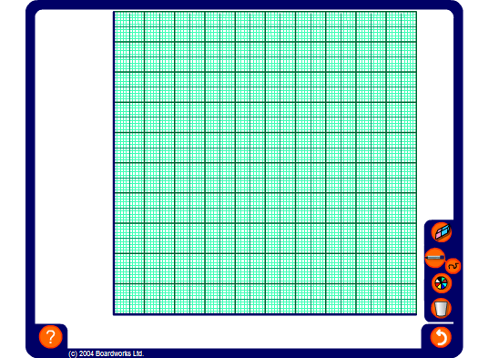


Scatter graphs
We can use scatter graphs to find out if there is any relationship or correlation between two sets of data.
Hand span (cm)
18
16
20
15
16
21
19
17
20
18
Foot length (cm)
24
21
28
20
22
30
25
22
27
23
Notes:
Explain that the table shows the hand span and foot length of ten children and that we can plot the hand span against the foot length for each child.
Start by deciding on an appropriate labels and scale for the axes by considering the range for each measurement.
Number the axes using the pen tool and ask volunteers to come to the board and plot the points.
When the point have been plotted ask pupils if we can deduce anything from this graph.
Suggest that we might get a better overall picture if there was more data.

Slide 3

Scatter graphs and correlation
We can use scatter graphs to find out if there is any relationship or correlation between two sets of data.
For example,
Do tall people weigh more than small people?
If there is more rain, will it be colder?
If you revise longer, will you get better marks?
Do second-hand car get cheaper with age?
Is more electricity used in cold weather?
Are people with big heads better at maths?
Notes:
For each example, discuss the data that would have to be collected and what you would expect the result to be.

Slide 4
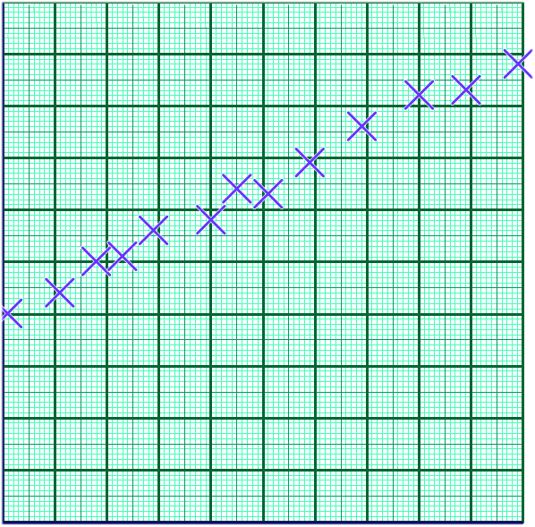
Scatter graphs and correlation
When one variable increases as the other variable increases, we have a positive correlation.
For example, this scatter graph shows that there is a strong positive correlation between the length of a spring and the mass of an object attached to it.
Length of spring (cm)
The points lie close to an upward sloping line.
This is the line of best fit.
Mass attached to spring (g)
Notes:
Establish that this graph shows that the more mass is attached to the spring, the longer it stretches.
You may like to point out that if we had a perfect positive correlation, all of the points would lie on the same straight line. It this case there would be a mathematical formula linking the two variables. The length of a spring and the mass attached to it may have a perfect correlation. However, other factors such as errors in measurements, mean that when we conduct an experiment the points do not usually lie on the same straight line.
Link:
A6 Real-life graphs – plotting graphs

Slide 5
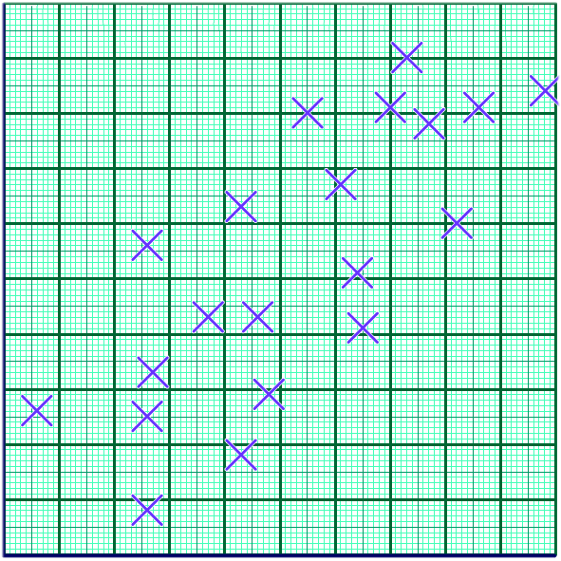
Scatter graphs and correlation
Sometimes the points in the graph are more scattered. We can still see a trend upwards.
This scatter graph shows that there is a weak positive correlation between scores in a maths test and scores in a science test.
Science score
The points are scattered above and below a line of best fit.
Maths score
Notes:
Establish that this graph shows that, in general, the better a pupil is at maths, the better they are at science.

Slide 6
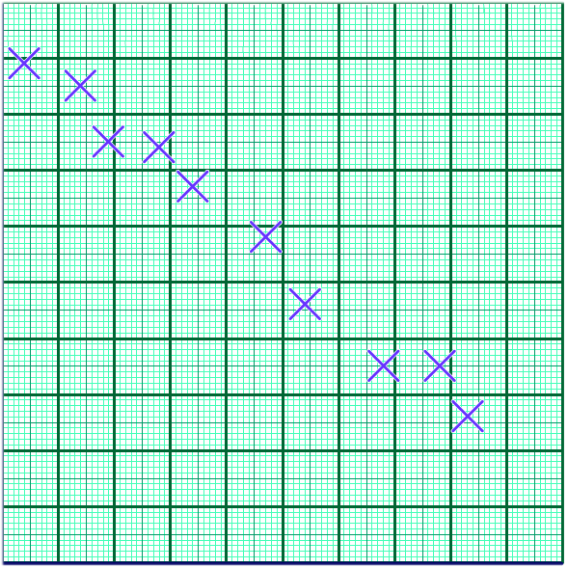
Scatter graphs and correlation
When one variable decreases as the other variable increases, we have a negative correlation.
For example, this scatter graph shows that there is a strong negative correlation between rainfall and hours of sunshine.
Temperature(°C)
The points lie close to a downward sloping line of best fit.
Rainfall (mm)
Notes:
Establish that this graph shows that the more rain there is, the colder it is. In other words, the lower the temperature the greater the rainfall.

Slide 7
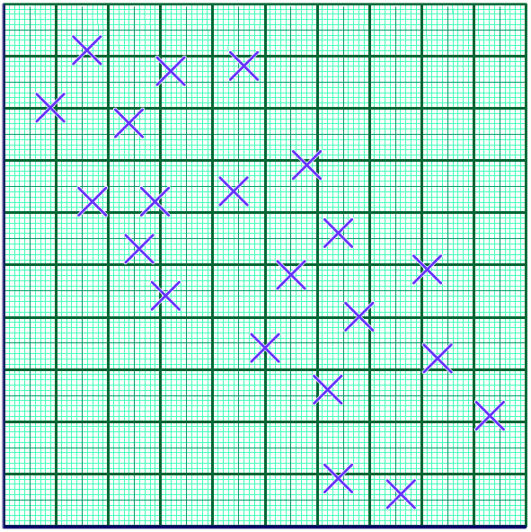
Scatter graphs and correlation
Sometimes the points in the graph are more scattered.
We can still see a trend downwards.
For example, this scatter graph shows that there is a weak negative correlation between the temperature and the amount of electricity a family used.
Outdoor temperature (ºC)
Electricity used (kWh)
Notes:
Establish that this graph shows that the colder it is, the more electricity the family uses.
Ask pupils to explain why the family might use more electricity on colder days.

Slide 8
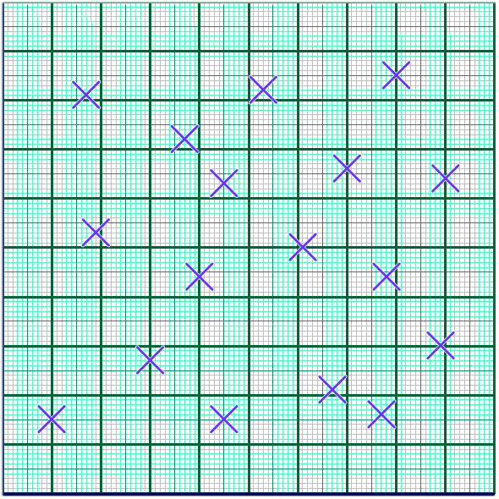
Scatter graphs and correlation
Sometimes a scatter graph shows that there is no correlation between two variables.
For example, this scatter graph shows that there is a no correlation between a person’s age and the number of hours they work a week.
Number of hours worked
The points are randomly distributed.
Age (years)
Notes:
Ask pupils to show a point that could represent a younger person who works long hours. What about a point that could represent an older person who works for only a few hours? A younger person who works for only a few hours? An older person who works long hours?

Slide 9
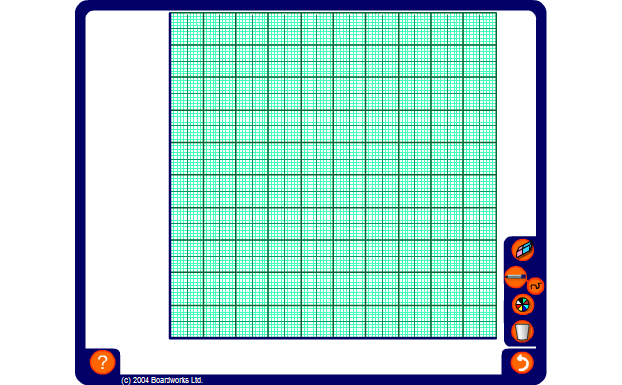
Plotting scatter graphs
This table shows the temperature on 10 days and the number of ice creams a shop sold. Plot the scatter graph.
Temperature (°C)
14
16
20
19
23
21
25
22
18
18
Ice creams sold
10
14
20
22
19
22
30
15
16
19
Notes:
Ask pupils to predict whether or not there will be any correlation shown by the data.
Decide on labels and an appropriate scale for the axes by considering the range for each measurement and number the axes using the pen tool.
Ask volunteers to come to the board and plot the points from the table on the diagram.
Decide if there is any correlation between the values and use the pen tool (set to draw straight lines) to draw a line of best fit.

Slide 10
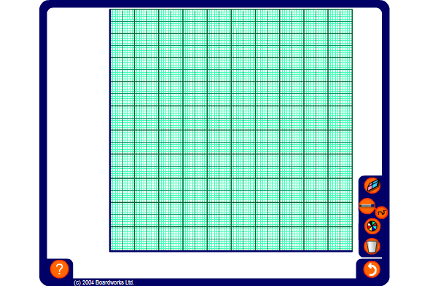
Plotting scatter graphs
We can use scatter graphs to find out if there is any relationship or correlation between two set of data.
Hours watching TV
2
4
3.5
2
1.5
2.5
3
5
1
0.5
Hours doing homework
2.5
0.5
0.5
2
3
2
1
0
2
3
Notes:
Ask pupils to predict whether or not there will be any correlation shown by the data.
Decide on labels and an appropriate scale for the axes by considering the range for each measurement and number the axes using the pen tool.
Ask volunteers to come to the board and plot the points from the table on the diagram.
Decide if there is any correlation between the values.
Use the pen tool (set to draw straight lines) to draw a line of best fit, if appropriate.
Copy this slide and modify the table to produce more examples if required.

